Slide 1
Travel Training Across All Ages:
Comparing Transition-Age Students
and Older Adults
Melody Bundy - Program Manager
Nieves G. Pimienta - Bilingual Travel Instructor
ATI Annual Conference, St. Paul
Presented by NJTIP @ Rutgers
Alan M. Voorhees Transportation Center
August 4, 2016

Slide 2
Agenda
Explain TIP Smart: Senior Mobility and Resource Training (Older Adult Program)
Explain BE TIP: Buddy Empowered Travel Instruction Program (Transition Age Student Program)
Compare Training Older Adults and Transition Age Students

Slide 3
Voorhees Transportation Center (VTC)
VTC is one of 17 research centers at the Edward J. Bloustein School of Planning & Public Policy at Rutgers University
Leader in the research and development of innovative transportation policy…
Safe Routes to School
Complete Streets
NJ Bicycle and Pedestrian Resource Center
NJTIP @ Rutgers

Slide 4
Preparing for the Age Wave
US Department of Health and Human Services - 2010

Slide 5
Aging Impacts Mobility
21% of people 65+ do not drive
People who retire from driving at 70, spend 6 -10 years “dependent on others to meet their transportation needs”
More than 50% of non-drivers age 65+ stay home on a given day (3X as many as drivers)
Driving cessation by people 65+ = less independence and more isolation
Aging Americans: Stranded Without Options: 2004

Slide 6
Sensitivity Training
https://www.youtube.com/watch?v=mSiyFZl1dKI

Slide 7
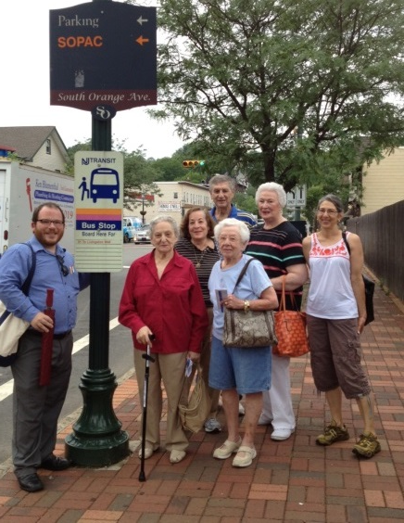
Transportation in Aging in Place Programs
LIVE – Lifelong Involvement for Vital Elders
Parsippany, Caldwell, Verona
On the GO!
South Orange, West Orange, Union County
TIP SMART
Senior Mobility and Resource Training
Passaic and Bergen Counties

Slide 8
Project - TIP SMART
Senior Mobility and
Resource Training

Slide 9
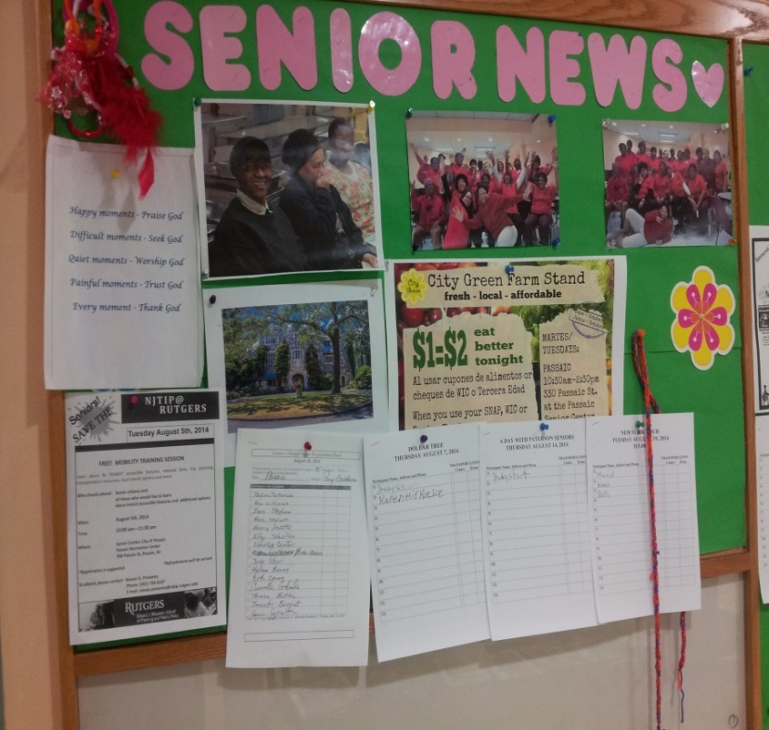
Tactics for Reaching Older Adults
Assess the opportunity
Naturally occurring groups
Agencies, organizations and partners
Meeting of the minds – buy-in
Deploy program
Capture & measure results

Slide 10
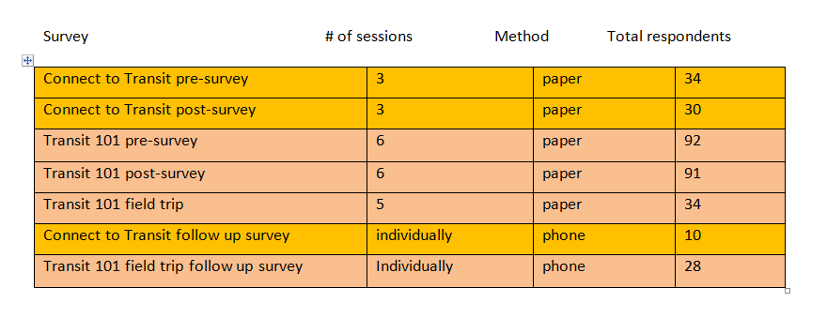
Scope of the TIP SMART program

Slide 11
Transit 101 90 minutes “Classroom” Session on Transit
Elements:
Power point presentation
Booklets specific to neighborhoods and communities
Day travel trip with date(s), and potential destinations.
Sustainable destinations

Slide 12
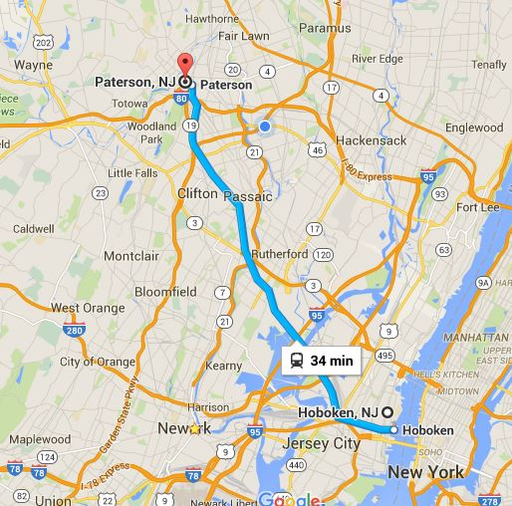
Sustainable Destinations
What does it mean?
What is accessibility?
Are there alternatives?

Slide 13
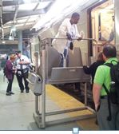
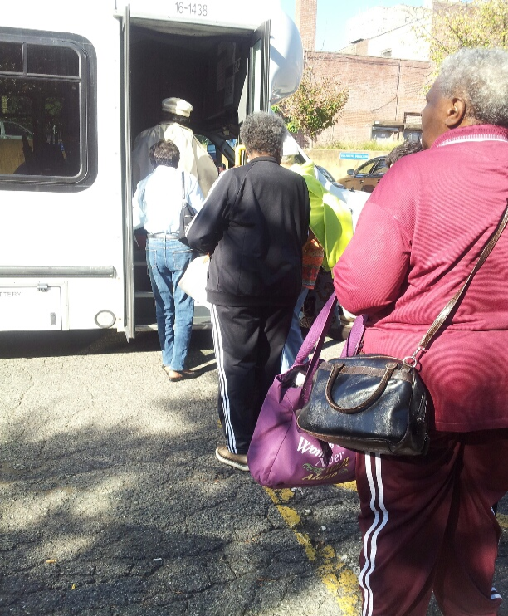
Senior Group Trips
Canfield Residence Group: destination Hoboken
GAP Relatives: destination Hoboken
Passaic Senior Center Group : destination Secaucus Junction
Canfield Residence Group: destination Hoboken
GAP Relatives: destination Hoboken
Passaic Seniors: destination Secaucus Junction
.

Slide 14
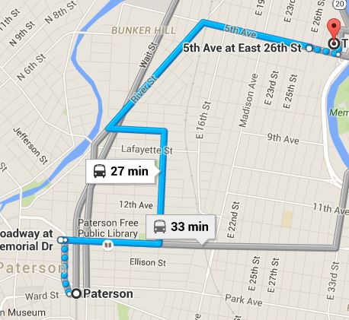
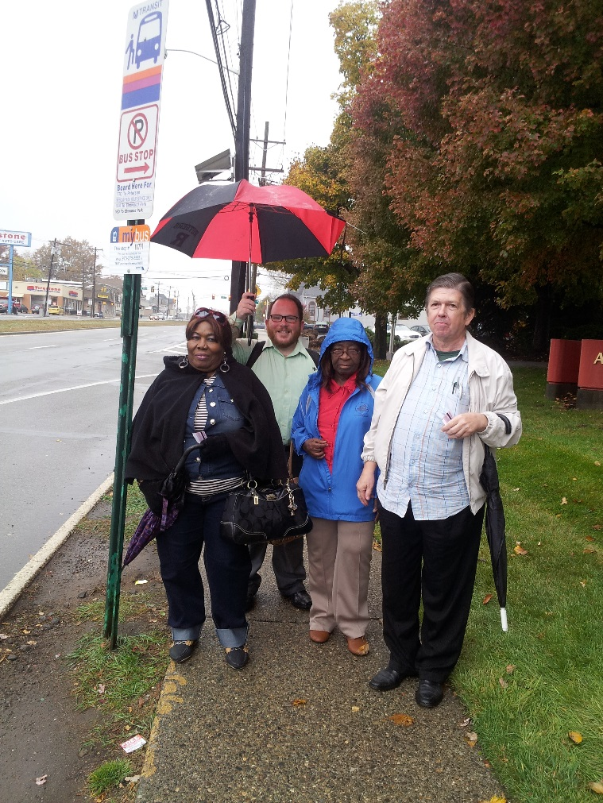
Catholic Family Services Senior Group

Slide 15
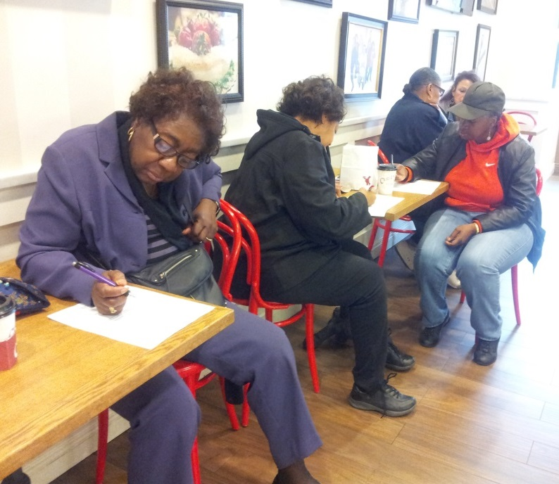
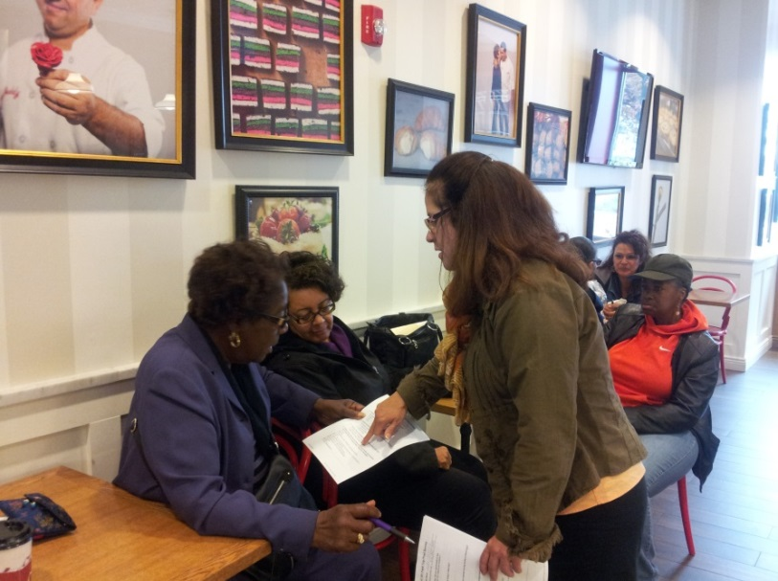
What NJTIP Learned
Observations from 92 seniors
79% rated transportation as “very important”
Most frequent modes:
52% bus
31% walk
31% non-profit car/van/bus
70% without reduced fare card
38% used a mobility device

Slide 16
What the Older Adults Learned
75% learned “ a great deal” from the session
70% reported knowing how to plan a trip on public transit after training, as compared to 42% before training
72% reported an interest in additional travel training
And After Follow Up…
82% reported feeling more confident with independent public transit travel after field trip participation
56% reported they had taken 1 or more trips using public transit since program participation

Slide 17
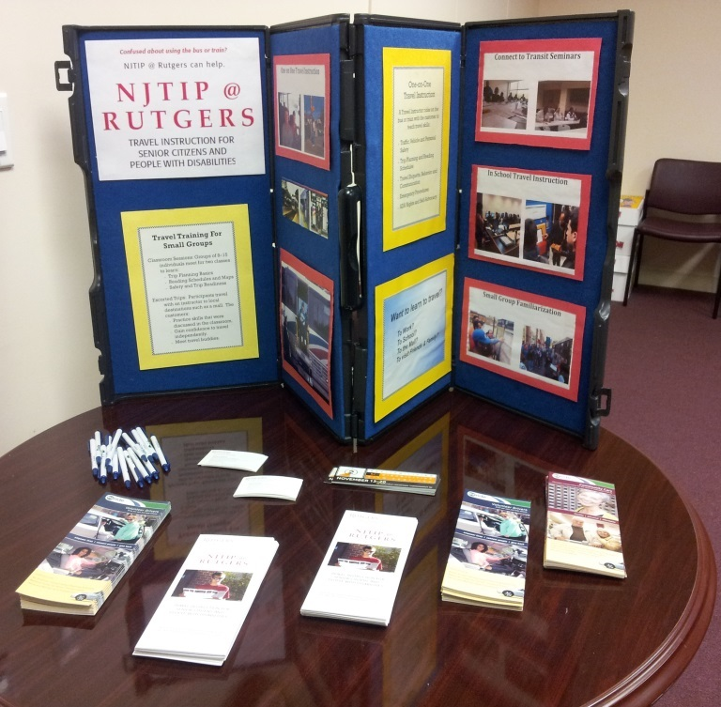
Older Adults - Tactics Used in Travel Training
Buddy system
Hands-on repetition
Use of tangible tools
Destination
Focus on the benefits
Unintended consequences

Slide 18
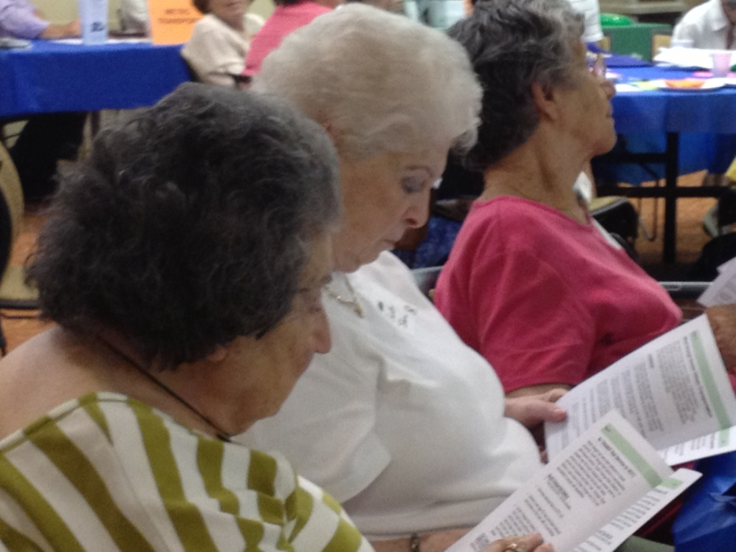
Additional Considerations
Large print …yes print
Embarrassment and inferiority - feeling like a burden
Afraid to admit their own limitations
Leading by example (or through demonstrations)

Slide 19
Project - BE TIP
Buddy Empowered
Travel Instruction Program

Slide 20
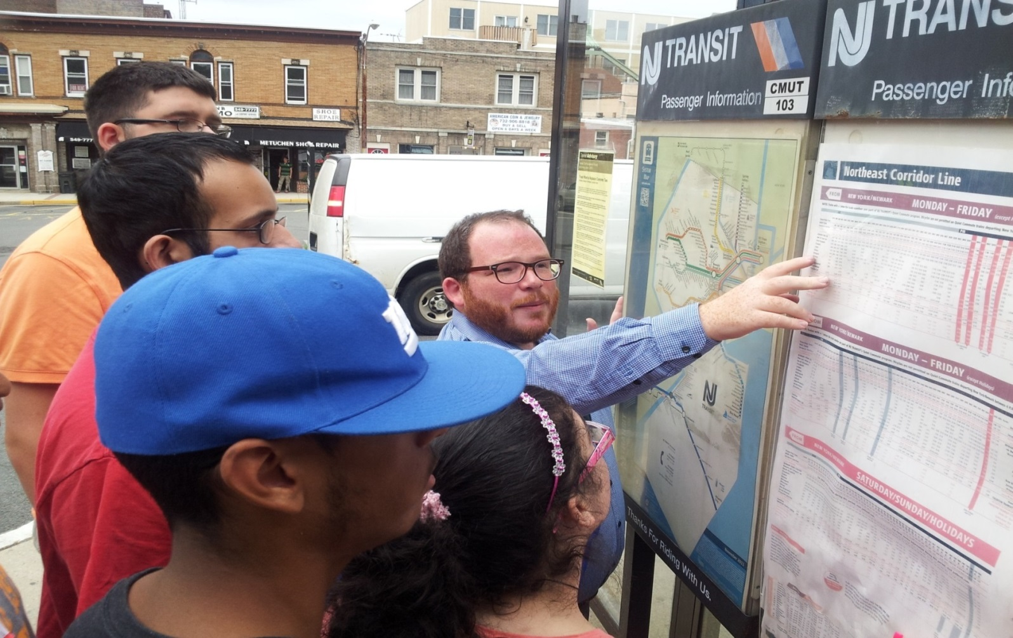
Transition Age Students

Slide 21
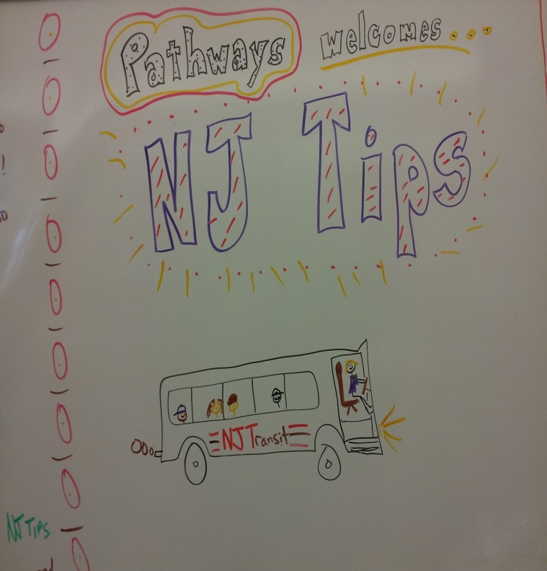
Tactics for Reaching Transition Age Students
Make connection with transition coordinators and/or special education directors
Discuss scope of training
Coordinate transit and school schedule
Capture and measure results

Slide 22
Transit 101 60 Minutes “Classroom” Session on Transit
Elements:
Power point or lecture/discussion
Role playing to reinforce lessons and skills
Day of trip details discussed with staff and potential destinations
Sustainable destinations

Slide 23
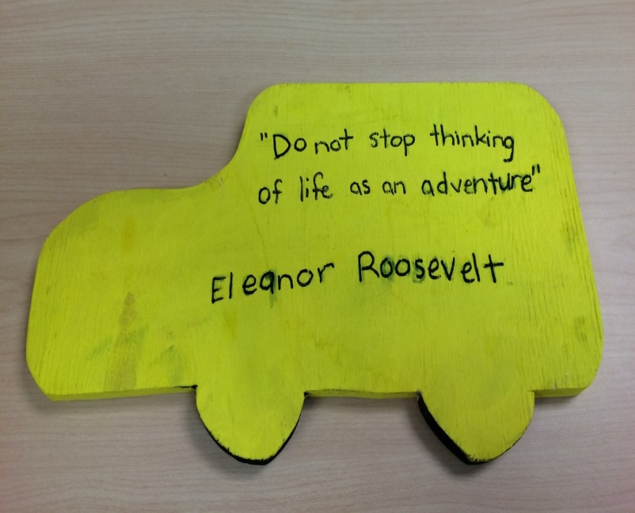
Community Based Instruction Locations
What does it mean?
What is accessibility?
Are there alternatives?

Slide 24
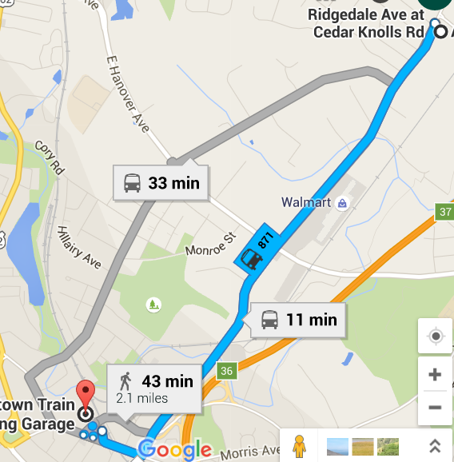
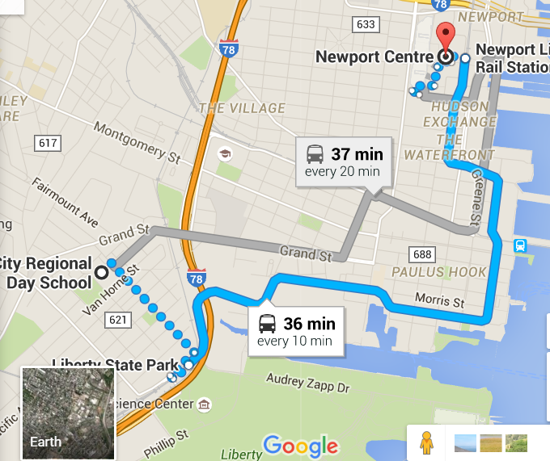
Community Based Instruction Allegro School Jersey City Regional Services The Children’s Institute
Canfield Residence Group: destination Hoboken
GAP Relatives: destination Hoboken
Passaic Senior Center Group : destination Secaucus Junction
.

Slide 25
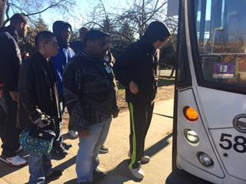
Jewish Vocational Service

Slide 26
What NJTIP Learned from Transition Students
Observations from 71 participants
80% rated transportation as “very important”
Most frequent modes:
58% school bus
35% walk
35% Access Link (ADA Paratransit)
Gender - 70% male
Age – 15-20 years old

Slide 27
What the Transition Age Students Learned
95% learned “ a great deal” from the session
80% reported knowing how to plan a trip on public transit after training, as compared to 40% before training
60% reported an interest in additional travel training

Slide 28
Additional Considerations When Training Transition Students
This is a new thing for some students
Goals of parents compared to transition coordinator
Embarrassment – fear that their friends would laugh if can’t do something
Repetition
Some students are not aware of the importance

Slide 29
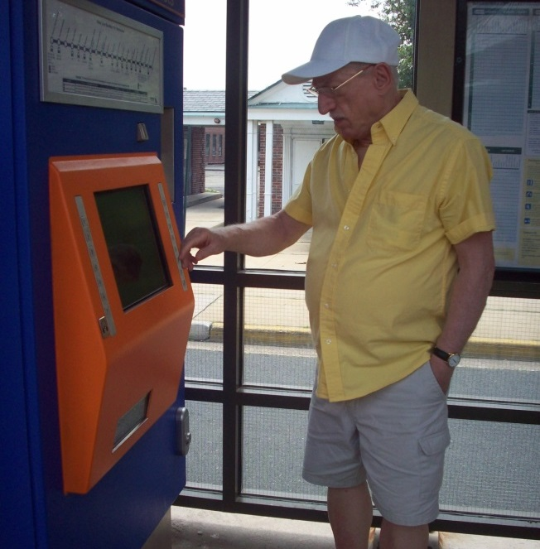
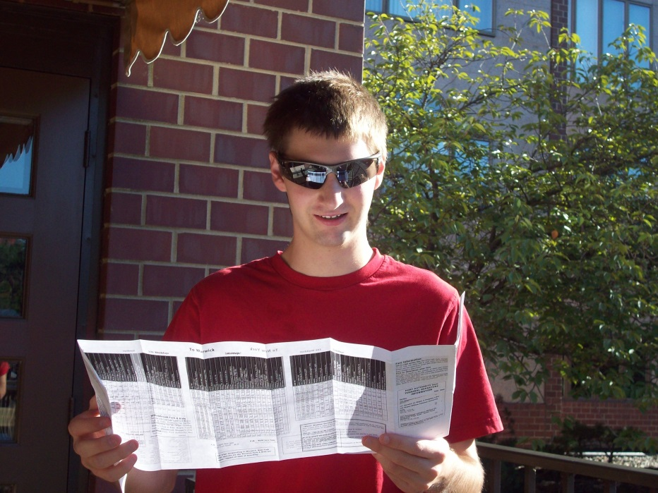
Comparison
Older Adults
Transition Age Students

Slide 30
Training Locations
Older Adult
Transition Age Students
Senior housing facilities
Municipal senior centers/organizations
Agencies and organizations for individuals with disabilities
Community based organizations serving transportation disadvantaged populations
School
Day program

Slide 31
Transportation Experience
Older Adult
Transition Age Students
Last time used was 20-50 years ago
Last time rode on public transportation was prior to ADA
May use with family
Never used before

Slide 32
Comparing Travel Training of Older Adults and Transition Age Students
Benefits
Client/trainer dynamic
Client’s perception of public transit
Life’s demands
External factors affect the group
Technology
Buddy system
Locations/destinations
Independence
Support group

Slide 33
Contact Information
Melody Bundy
Program Manager, NJTIP @ Rutgers
melody.bundy@njtip.rutgers.edu
973-445-5950
Nieves G. Pimienta
Bilingual Training Coordinator, NJTIP @ Rutgers
nieves.pimienta@njtip.rutgers.edu
201-724-6167
Alan M. Voorhees Transportation Center
Rutgers, The State University of New Jersey
33 Livingston Avenue
New Brunswick, New Jersey 08901
Phone (848) 932-4499
Fax (732) 932-3714

