Slide 1
Spontaneous Living:
The Americans with Disabilities Act
And Travel Training
Geoff Ames and Sandy Lahmann
2012 ATI Annual Conference

Slide 2
Meeting the Challenge, Inc.
For individuals with rights and organizations with responsibilities for compliance with federal disability laws, Meeting the Challenge, Inc. (MTC) is an information services consulting firm that:
Generates materials and products that support accessibility
Offers customized consulting services
Municipal Self Evaluations and Transition Plans
Transit Facility and Program Accessibility
Provides training on various disability rights laws
Notes:
Move through quickly

Slide 3
Projects of Meeting the Challenge
Transit Access Project - MTC completed a cooperative agreement with the Federal Transit Administration of the U.S. Department of Transportation which consisted of developing materials for individuals and organizations to help them better understand and implement the regulations for public transit systems under the ADA. As part of this effort, MTC has completed a research project, and developed materials, a transit portal, and trainings for transit providers and riders with disabilities.
Notes:
Move through quickly

Slide 4
Projects of Meeting the Challenge
Rocky Mountain ADA Center - One of the 10 regional ADA centers composing the ADA National Network. We provide technical assistance on the ADA to individuals and organizations in Colorado, Utah, Wyoming, North Dakota, South Dakota and Montana.
Notes:
Move through quickly

Slide 5
Regional ADA Centers
1-800-949-4232
www.adata.org
Notes:
Move through quickly

Slide 6
ADA Center services
Technical assistance / ADA information
Referral and networking with other disability organizations
Training
Material dissemination
Research
Notes:
Move through quickly

Slide 7
Newsletter
Keep up to date!
Monthly e-newsletter: Rocky Mountain Access
Print newsletter (2 to 3 times per year)
Sign up: www.adainformation.org
Free!
Notes:
Move through quickly

Slide 8
Disclaimer
Information, materials, and/or technical assistance are intended solely as informal guidance, and are neither a determination of your legal rights or responsibilities under the ADA, nor binding on any agency with enforcement responsibility under the ADA.
ADA Center authorized by NIDRR to provide information, materials, and technical assistance to individuals and entities that are covered by the ADA.
Notes:
Move through quickly

Slide 9
The Importance of Travel Trainers
The ADA does not mandate the availability or use of travel training
Nevertheless, travel training is a key component to the development of integrated, accessible fixed route transit systems and fulfillment of the spirit of the ADA
Travel training is a cost effective tool for transit agencies to increase fixed route travel and reduce paratransit costs
Notes:
What type of organization do you represent? Transit agency? ILC? Disability specific organization? Senior organization? School district?

Slide 10
The Importance of the ADA to You
Will improve your skills as a travel trainer and help you to empower your clients
Will magnify your impact and assist you in improving accessibility in your community
Will help you to become an accessible transit ambassador in your community, helping you to form effective coalitions with other agencies and organizations
Notes:
Knowledge of the regulations allows travel trainers to provide more effective travel training, act as an advocate for your clients with the transit agencies, assist your clients in becoming better self-advocates, and provide more effective guidance to other community and disability organizations.

Slide 11
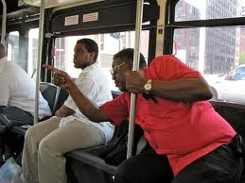
ADA Transit Regulations
Riders’ Guide to Public Transit for People with Disabilities
http://www.transitaccessproject.org/InternalDocs/RiderInfo/ridersguide.pdf

Slide 12
The Relationship: Fixed Route & Paratransit
Fixed route – bus, light rail, rapid rail (subway system) on which a vehicle is operated along a prescribed route according to a fixed schedule
Comparability between ADA complementary paratransit service and fixed route service
ADA complementary paratransit is intimately tied to fixed route – same geographical area, same service hours, comparable service
Fixed route agencies provide paratransit or contract with another service to provide paratransit
Notes:
Move through quickly

Slide 13
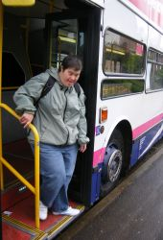
The Relationship: Fixed Route & Paratransit
Not every person with a disability is eligible for paratransit
A rider with a disability is eligible for paratransit only if she is unable to access the fixed route
Notes:
Emphasize. Paratransit is not a special transportation service for pwd that is designed to meet all their transportation needs.

Slide 14
Paratransit Eligibility Criteria
The following individuals with disabilities are eligible for ADA complementary paratransit:
Unable to independently navigate the fixed route system.
No accessible fixed route vehicle is available.
Unable to get to or from transit stop or station because of disability or disability prevents negotiating environmental barriers

Slide 15
The Limitations of Paratransit
Day ahead reservations
Negotiated pick-up time: hour before to an hour after the requested time.
Pick-up window
On the curb waiting for the bus
Typically, 15 minutes before/15 minutes after scheduled pick-up time.
Shared rides/multiple stops
Ride times may be comparable to fixed route
Rides can cost as much as four times fixed route fare during non-peak hours. (Twice as much during peak hours.)

Slide 16
Why is this Important?
An overreliance on paratransit has resulted in
Lack of independent, spontaneous, integrated transit opportunities for individuals with disabilities
Transit agency budget problems that threaten transit systems
Travel training is part of the solution
Your understanding of this dynamic will increase your effectiveness as a travel trainer, help you to effectively market your service, and magnify your impact

Slide 17
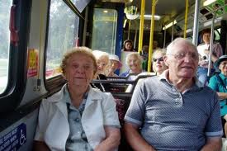
Accessible Public Transit???
Lex Frieden - “Research reveals that many barriers to transportation continue to exist that prevent full inclusion and full participation of people with disabilities in society.”
Lex Frieden, Chairperson, National Council on Disability, The current State of Transportation for People with Disabilities in the United States, June 13, 2005

Slide 18
Our Proposition
Binary model of separate fixed route and ADA complementary paratransit service is broken
Riders with disabilities face “short-bus” segregation
Result of failed implementation of the ADA.
We will recommend solutions to facilitate integration of riders with disabilities, promote community inclusion, and cut costs
(TRAVEL TRAINING!!)

Slide 19
The Broken Paradigm
Paratransit riders experience capacity constraints and service problems
Transit systems experience unsustainable escalation of paratransit costs
Resources diverted to provide paratransit are not available to increase accessibility on the fixed route
Riders who could use accessible fixed route must continue to depend on paratransit
Notes:
Mountain Metro in Colorado Springs has indicated they are seeing an annual increase of 10% in their paratransit costs and have also experienced significant cuts in service and routes.

Slide 20
The Intention of the ADA
Promotes civil rights and equality, not special privileges
Requires “integrated setting appropriate to…”
Intended paratransit to be a safety net, only to be used until fixed routes were made accessible, or for those few individuals who are unable to access fixed route even when all barriers are removed
Never intended paratransit to operate like a taxi service, but expected paratransit rides to be as long as fixed route rides and be comparable in all areas
Notes:
§ 35.130 General prohibitions against discrimination
(d) A public entity shall administer services, programs, and activities in the most integrated setting appropriate to the needs of qualified individuals with disabilities.

Slide 21
ADA Expectations
Fixed route services would become fully accessible
State and local governments would
Identify barriers through Self Evaluation and Transition Plans
Remove barriers
Make all public rights-of-way accessible
Accessible fixed route would – over time – reduce the demand for paratransit

Slide 22
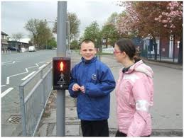
22 Years Later
What types of barriers to the fixed route are your clients experiencing?
Notes:
What barriers have you seen that are preventing your clients from riding fixed route?

Slide 23
National Transportation Access Research Project: A Survey of Riders with Disabilities
What barriers have you encountered in your use of public transportation in the last 12 months?
29% Drivers not calling out stops
25% No accessible route to the public transit stop
25% Driver attitude
22% Drivers lack knowledge
19% Inability to navigate system
19% Inaccessible public transit stop or station

Slide 24
National Transportation Access Research Project: A Survey of Riders with Disabilities
18% Gap or step to transit vehicle
16% Problems with lifts
13% Drivers refusing to stop
7% Securement issues
5% Service animal issues
National Transportation Access Research Project: A Survey of Riders with Disabilities, Meeting the Challenge, Inc., 2009.
http://www.transitaccessproject.org/InternalDocs/Research/SurveyOfRidersWith%20Disabilities2009-MTC.pdf

Slide 25
Fixed Route Barriers = Paratransit
For people who are blind or have
low vision, lack of stop
announcements is a barrier
For people who have mobility
disabilities inaccessible stops,
inaccessible sidewalks, inaccessible
intersections, inoperable lifts, and
unmaintained securements are barriers
For people who have intellectual disabilities, who are blind, or seniors, not being able to navigate the system is a barrier.

Slide 26
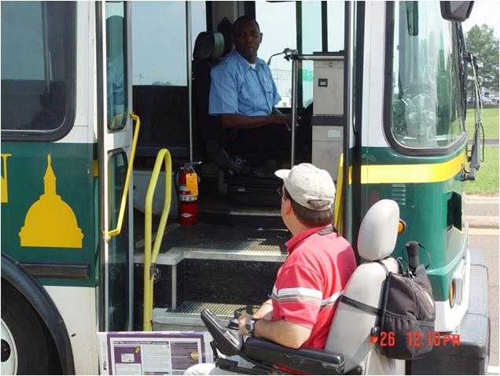
The Stats
1989 – 36% of the bus fleet nationally, was accessible
2002 – 91.4% of transit buses were equipped with ADA lifts/ramps and securements

Slide 27
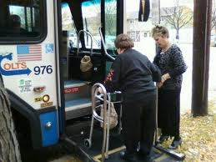
The Stats
1991 – ADA related paratransit services accounted for about 16 million trips
2001 – ADA related paratransit services accounted for almost 48 million trips

Slide 28
22 Years Post ADA
Segregated transportation for people with disabilities used three times as much as it was before the ADA
Despite the fact that three times as many fixed route vehicles are now accessible

Slide 29
Trebling of Demand for Paratransit
Represents an enormous expansion of mobility for people with disabilities
Suggests that significant and widespread barriers continue to exclude many people with disabilities from accessing fixed route

Slide 30
Segregation
For those who are able to ride accessible fixed route systems, continued diversion to paratransit with its advance reservation structure amounts to continued discrimination and segregation on the basis of disability
Separate is not equal

Slide 31
A History of Transit and Disability Rights
Why is this important?
Many people with disabilities and their families are reluctant to ride fixed route but would rather stay on paratransit. Understand why.
Reminding these individuals of this history will increase their commitment to integrated, fixed route travel
Knowledge of the history will help you to be a better advocate

Slide 32
A History of Transit and Disability Rights
To Ride the Public’s Buses: The Fight that Built a Movement
Edited by Mary Johnson and Barrett Shaw
Anthology of articles from “The Disability Rag” (1983-1990) relating events of the disability rights movement’s struggle to access public transit

Slide 33
History
From 1978 through the 1980’s, prior to the passage of the ADA, ADAPT* members with disabilities chained themselves to public buses and shut down public bus service while demanding that they be given an opportunity to ride integrated public buses.
* American Disabled for Accessible Public Transportation, a project of Atlantis, an independent living center in Denver

Slide 34
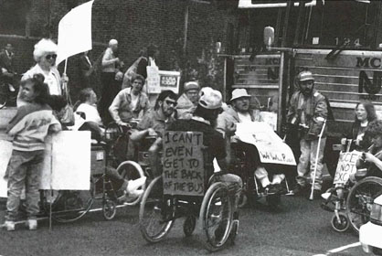
History
ADAPT activist Mark Johnson – “Black people fought for the right to ride on the front of the bus. We’re fighting for the right to get on the bus.”
“Protest, Power, and Change, An Encyclopedia of Nonviolent Action from ACT-UP to Women’s Suffrage”, Roger S. Powers, et al., 1997, pg. 11.

Slide 35
History
During this time, APTA (American Public Transportation Association) opposed access to public buses
APTA insisted that paratransit was a better alternative

Slide 36
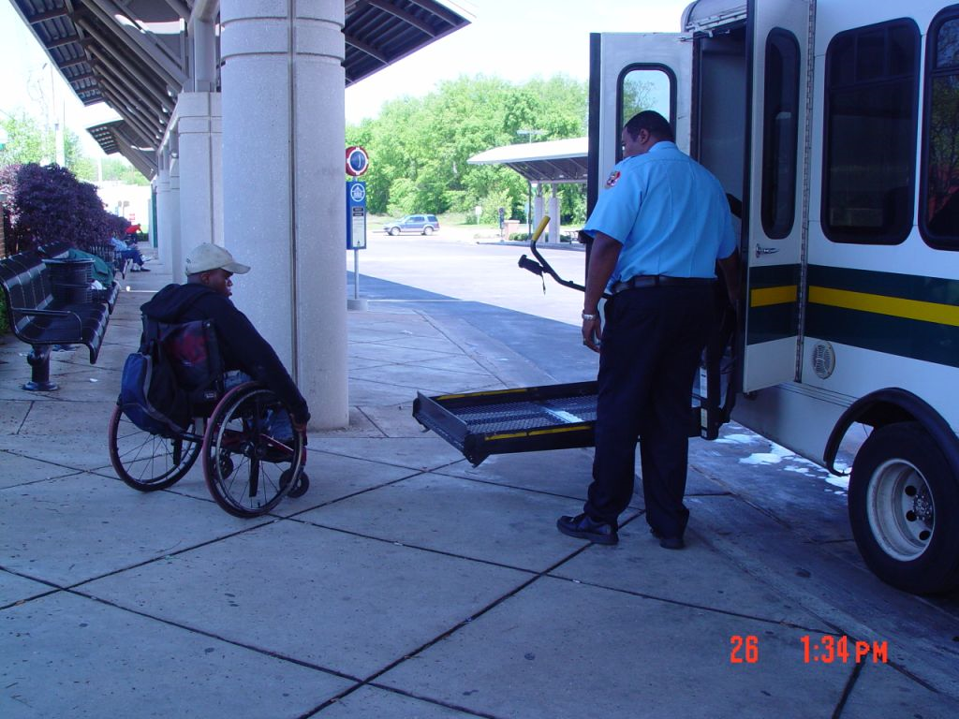
History
ADAPT members disagreed and continued to block buses because they did not believe paratransit rides would give them equal rights…

Slide 37
History
When the ADA was signed into law in 1990, it did not create the idea of paratransit
Put parameters on how paratransit must be operated
Set the expectation that paratransit would be a safety net, until the fixed route buses became accessible
Set requirements for fixed route accessibility

Slide 38
Reduced Expectations
For decades, people with disabilities were told to ride paratransit, so they did.
Although lifts and ramps are now on fixed route buses, many other barriers still exist, which means often people with disabilities have no choice but paratransit.
People with disabilities have become so accustomed to paratransit they often no longer advocate for access to fixed route. They expect “special” transportation services.
However, they find paratransit’s negotiated advance reservation system, sometimes poorly implemented, to be inadequate.

Slide 39
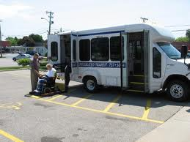
Is segregated transportation as good as it gets for people with disabilities?

Slide 40
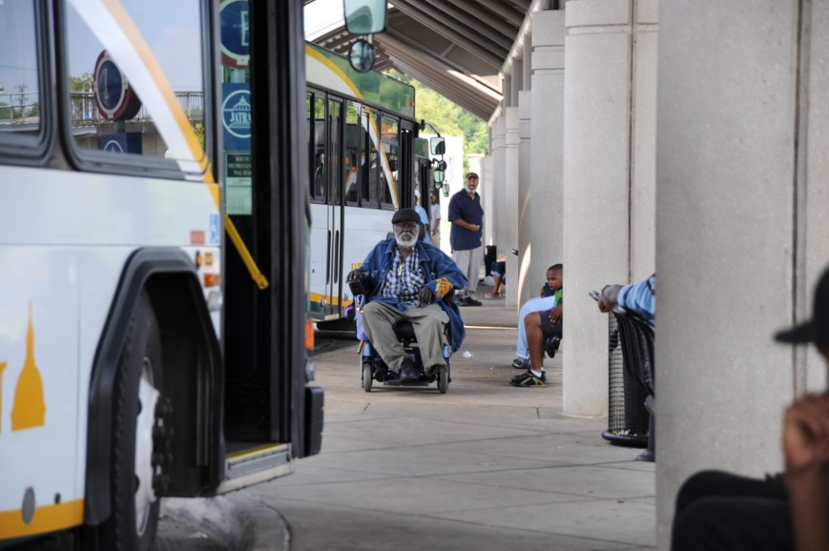
Win – Win for Everyone
Creating maximum accessibility on fixed route systems is a win for riders with disabilities, it’s a win for transit agencies, and it’s a win for communities.

Slide 41
Riders with Disabilities Win
When riding an accessible fixed route system, people with disabilities
Are integrated into the mainstream of society and the stigma of the short bus is eliminated
Experience greater independence and spontaneity
Are able to avoid the limitations of paratransit

Slide 42
Transit Agencies Win
When transit agencies and communities remove barriers that prevent riders with disabilities from riding fixed routes, transit agencies are able to
Increase fixed route ridership
Reduce the number of paratransit trips
Save money and reduce budget problems
Retain routes and service levels on fixed route
Reduce capacity constraints on paratransit
Reduce service problems related to capacity constraints on paratransit
Reduce complaints from paratransit riders

Slide 43
Transit Agencies Win
Cost-benefit analysis
If an individual with a disability is riding paratransit to commute to her job 5 days per week, 50 weeks per year (500 trips a year), and
The cost difference of each of those paratransit trips for the transit agency is $25 per trip (a conservative estimate),
The total yearly cost for the transit agency to provide paratransit to that one individual to go to work is $12,500.
If those trips can be converted to fixed route trips, the transit agency will save $12,500 for that one individual.

Slide 44
Our Communities Win
Better use of tax money
Cost-benefit analysis
For our individual riding paratransit to work at a cost of $12,500 per year,
Perhaps the barrier preventing that individual who is a wheelchair user from riding fixed route is the need for two curb ramps.
The cost of constructing two curb ramps could be as little as $5,000.
Fiscally responsible to construct the curb ramps and convert these trips to fixed route trips.
Notes:
Cost-benefit analysis for travel training vs providing paratransit rides

Slide 45
The Problem…
Transit districts sometimes lack jurisdiction to construct the needed curb ramps
City or county, having jurisdiction, must pay for the curb ramps, has its own budget problems and doesn’t see an immediate benefit for them
But the taxpayer who pays taxes to the transit district and the city/county – would benefit from tax stewardship of the transit district and the city/county working together to remove barriers

Slide 46
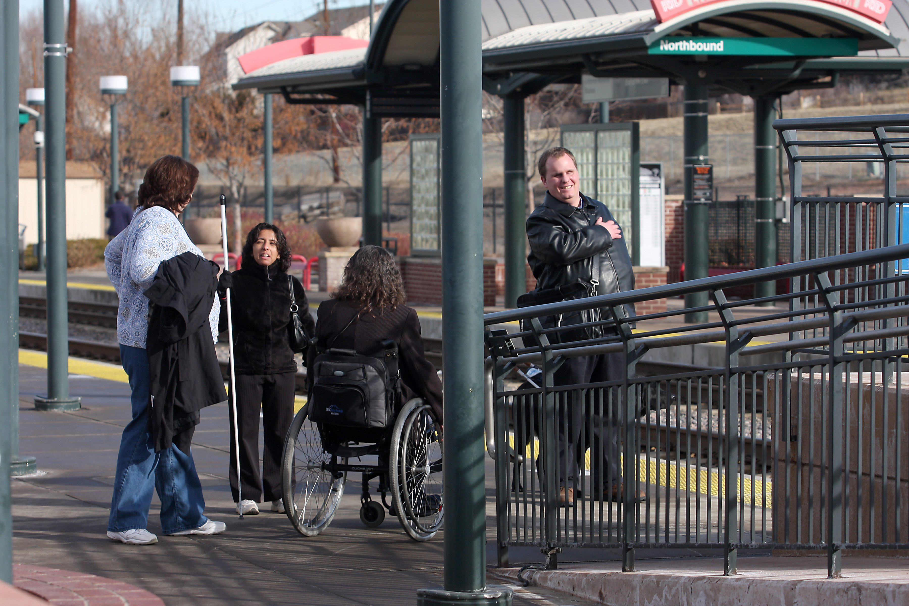
Our Communities Win
When riders with disabilities are able to consistently ride fixed route, they are then able to consistently get to their jobs on time and then . . .
tax users become tax payers!

Slide 47
What’s in it for You?
Knowing the economic benefits for transit systems when riders use fixed route instead of paratransit for all or even some of their trips gives travel trainers power
To market your travel training services
To negotiate with transit providers
To persuade fellow taxpayers to join your cause
To get policy makers/political leaders on your side

Slide 48
Bring all stakeholders to the table
Transit agencies must commit to removing barriers from fixed route transit systems
Local governments must commit to accessible public rights-of-way
Riders with disabilities must commit to getting on the integrated fixed route buses if they are able and must expect and advocate for accessibility on the fixed route
Disability advocacy organizations must advocate for accessible fixed route and encourage their consumers to ride the fixed route when able

Slide 49
Advocate Strategically
Use economic leverage to persuade policy makers
Accessible fixed route transit can provide more rides for less cost
Back to the basics – integration is a fundamental civil right

Slide 50
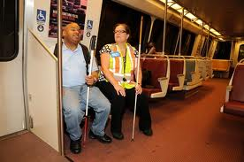
Methods to Improve Fixed Route Accessibility
Travel training!!!!
Conditional eligibility
Accessible public rights-of-way
Driver and staff training
Flexible fixed route services

Slide 51
Effective Travel Training
Begins with proper assessment
Know the needs, strengths, and weaknesses of your client
Train for the trips that offer best opportunity for success
Train for the most frequent trips your client takes
Not possible for everyone or every trip
Use peer trainers when available

Slide 52
Effective Travel Training
Process should identify barriers that prevent the rider from using fixed route for specific common trips (e.g., going to work)
Missing sidewalks and curb ramps
Inadequate traffic control at a busy intersection
Inaccessible bus stops
Failure of drivers to provide accessible, courteous service
Systematically remove those barriers
Form coalitions with transit agencies and local governmental entities

Slide 53
Engage the Community
Form coalitions between different organizations providing travel training and transit agencies
To market more effectively
To provide more comprehensive services
To work together with local government entities to remove barriers

Slide 54
Conditional Eligibility
Paratransit eligibility granted for some trips but not all
Problem: sometimes conditional eligibility is used to limit mobility (stick vs. carrot)
Goal: using paratransit eligibility process to identify and eliminate fixed route barriers and increase fixed route access without inappropriately eliminating paratransit eligibility

Slide 55
Conditional Eligibility:
Paratransit eligibility procedures should identify barriers that prevent the rider from using fixed route for specific common trips
Systematically remove those barriers

Slide 56
Conditional Eligibility
Once those barriers are removed, one can use fixed route for that trip and still use paratransit for other trips where barriers still exist
Eligibility conditioned on episodic limitations of an individual’s disability or on environmental conditions, such as extreme temperatures or precipitation, must err in favor of more eligibility, not less.

Slide 57
Accessible Public Rights-of-Way
Jurisdictional issues
No current ADA standards; however,
DOJ findings in Project Civic Action settlement agreements identify sidewalks as facilities that must be altered in order to provide equal programmatic access under Title II of the ADA.
http://www.ada.gov/civicac.htm

Slide 58
Accessible Public Rights-of-Way
Local government responsibilities
All pedestrian routes or walkways that have been newly constructed or altered since 1992 must have been built accessible
Must identify and list all existing intersections and walkways that need accessibility improvements (self-evaluation) and develop a plan to prioritize and schedule the removal of barriers (transition plan)

Slide 59
Accessible Public Rights-of-Way
“Revised Draft Guidelines for Accessible Public Rights-of-Way”
Developed by the U.S. Access Board
Adopted by the Federal Highway Administration as best practices
Predicted adoption by the Department of Justice as ADA standards: 2013?
http://www.access-board.gov/prowac/index.htm
Notes:
How can travel trainers participate in removing barriers in public rights-of-way?

Slide 60
Boots on the Ground
Travel trainers are in a unique position. They see better than any other professional what barriers are preventing their clients from accessing the fixed route.
Use this advantage to remove the barriers.
What processes are in place at your agency and in your community to remove barriers in the public rights-of-way?

Slide 61
Driver and Staff Training: Proficiency Required
Providing accessible, integrated service must be a priority for all personnel
Top down operating priority
There must be incentives to transit personnel to provide accessible service
It’s not about driving the bus; its about serving customers.
Ongoing training is critical and must be a priority
Until proficiency is reached
Ongoing refresher training to maintain proficiency
Notes:
Are there incentives for bus drivers to call out stops? What happens when they don’t?

Slide 62
Driver and Staff Training: Proficiency Required
Remember that one of the biggest barriers is attitudes… we must eliminate:
Prejudice and paternalism toward riders with disabilities
Assumptions that riders with disabilities are unable to act independently
Judgments based on generalizations or stereotypes that people with disabilities cannot independently travel safely

Slide 63
Driver and Staff Training: Proficiency Required
DOT regulations
Each public or private entity which operates a fixed route or demand responsive system shall ensure personnel are trained to proficiency, as appropriate to their duties, so that they operate vehicles and equipment safely and properly and assist and treat individuals with disabilities who use the service in a respectful and courteous way, with appropriate attention to the difference among individuals with disabilities. (37.173)

Slide 64
Flexible Fixed Route
Deviations of the fixed route – the fixed route bus deviates from normal route to pick up/drop off riders with disabilities, then returns to its usual route
Demand responsive – eligible rider calls to schedule
Real time or same day request preferred
Day in advance reservations, but this limits spontaneity
Varies in degree and method depending on community needs and characteristics
Can be offered to all passengers, not just passengers with disabilities to provide service in areas with limited demand
Notes:
Does or could your community improve access to fixed route transit with flexibility?

Slide 65
Advocacy & Riders with Disabilities
Transit Access Project:
Achieving Transit Access: An Action Guide
http://www.transitaccessproject.org/InternalDocs/General/AchievingTransitAccessActionGuide_MTC_3-8-2011.pdf
Includes
Crawford et al. v. City of Jackson (MS) and City of Jackson Public Transportation System (JATRAN): A Case Study
http://www.transitaccessproject.org/InternalDocs/General/JacksonCampaign_MTC_3-8-2011.pdf

Slide 66
Meeting the Challenge Resources
Transit Access Project
www.transitaccessproject.org
Check out our transit blog!
http://www.transitaccessproject.org/transit-blog.html

Slide 67
Meeting the Challenge Resources
Riders’ Guide to Public Transit for People with Disabilities http://www.transitaccessproject.org/InternalDocs/RiderInfo/ridersguide.pdf
National Transportation Access Research Project: A Survey of Riders with Disabilities
http://www.transitaccessproject.org/InternalDocs/Research/SurveyOfRidersWith%20Disabilities2009-MTC.pdf

Slide 68
Resources
Operational Experiences with Flexible Transit Services: A Synthesis of Transit Practices http://onlinepubs.trb.org/onlinepubs/tcrp/tcrp_syn_53.pdf

Slide 69
Resources
Rocky Mountain ADA Center
www.adainformation.org
1-800-949-4232 (Voice, TTY)
Federal Transit Administration (FTA)
www.fta.dot.gov/ada
1-888-446-4511 (Voice) 1-800-877-8339 (TTY)
U.S. Department of Justice
www.ada.gov
1-800-514-0301 (Voice) 1-800-514-0383 (TTY)

Slide 70
Resources
Easter Seals Project ACTION
www.projectaction.easterseals.com
1-800-659-6428 (Voice) 1-202-347-7385 (TTY)
TCRP - Transit Cooperative Research Program www.tcrponline.org
Disability Rights Education and Defense Fund (DREDF)
www.dredf.org/transportation
1-800-348-4232 (Voice/TTY)

Slide 71
Our Contact Information
Geoff Ames and Sandy Lahmann
Meeting the Challenge, Inc.
Operating the Rocky Mountain ADA Center
games@mtc-inc.com, slahmann@mtc-inc.com
www.adainformation.org
1-800-949-4232 (V/TTY)
719-444-0268 (V/TTY)
719-444-0252 (V/TTY)
719-358-2460 (VP)
3630 Sinton Road, Ste. 103
Colorado Springs, CO 80907

