Slide 1
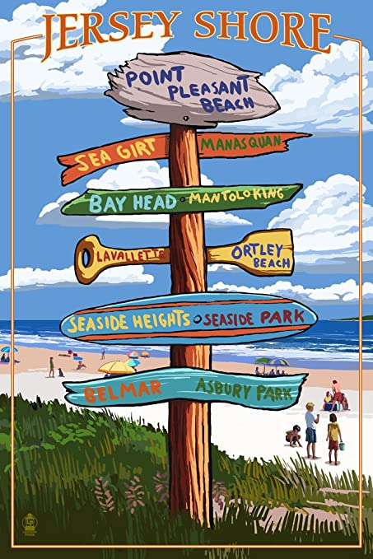
Designing and Implementing Virtual Group Field Trips During COVID-19
N
W
E
S
Presented by:
Jeffrey Dennis
NJTIP @ Rutgers
Research Prog. Coord.
Travel Instructor
Notes:
Good afternoon everyone, today I will be talking to you about creating virtual field trips for your customers. I will discuss my methods of collecting the various online multimedia content and information, and how to best consolidate that information into a cohesive presentation and virtual field trip for your customers.
It goes without saying that today’s current travel training environment has been greatly affected and possibly forever changed due to the COVID-19 pandemic. In response to this massive shift in travel training instruction, my team at NJTIP @ Rutgers realized that virtual travel training is the new standard for travel instruction programs. We have begun incorporating virtual travel training and virtual group field trips into our instructional “manual”, this new format of training allows our customers the continuity of travel instruction during a time where “real-time” travel instruction is not possible due to COVID-19 travel restrictions and health precautions.
Before I get into the creation of virtual field trips, I wanted to briefly talk about the world of travel training pre-COVID 19 and how my team and I had to adapt to the new world of virtual travel training.
Next slide: Pre-COVID 19 Travel training

Slide 2
Designing and Implementing Virtual Group Field Trips During COVID-19
Presented by:
Jeffrey Dennis
NJTIP @ Rutgers
Research Prog. Coord.
Travel Instructor
Notes:
Good afternoon everyone, today I will be talking to you about creating virtual field trips for your customers. I will discuss my methods of collecting the various online multimedia content and information, and how to best consolidate that information into a cohesive presentation and virtual field trip for your customers.
It goes without saying that today’s current travel training environment has been greatly affected and possibly forever changed due to the COVID-19 pandemic. In response to this massive shift in travel training instruction, my team at NJTIP @ Rutgers realized that virtual travel training is the new standard for travel instruction programs. We have begun incorporating virtual travel training and virtual group field trips into our instructional “manual”, this new format of training allows our customers the continuity of travel instruction during a time where “real-time” travel instruction is not possible due to COVID-19 travel restrictions and health precautions.
Before I get into the creation of virtual field trips, I wanted to briefly talk about the world of travel training pre-COVID 19 and how my team and I had to adapt to the new world of virtual travel training.
Next slide: Pre-COVID 19 Travel training

Slide 3
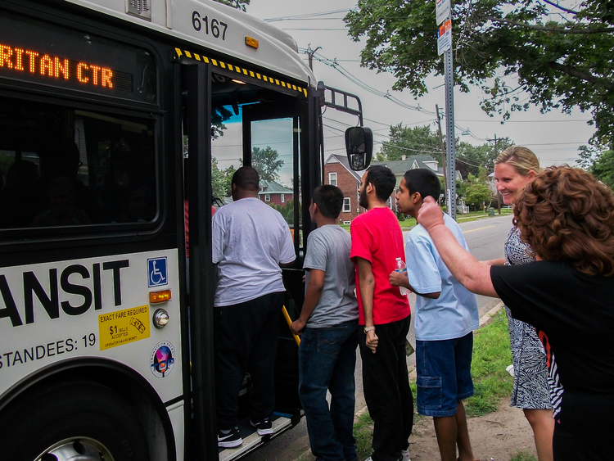
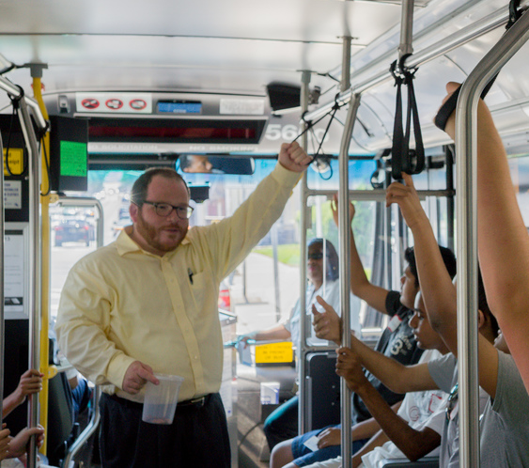
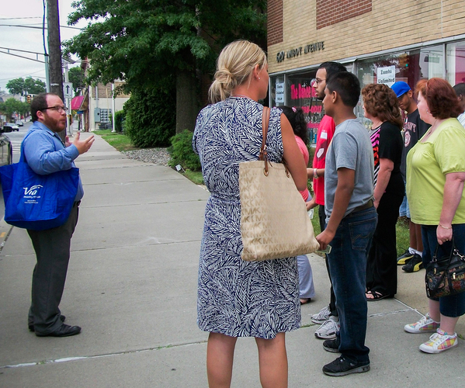
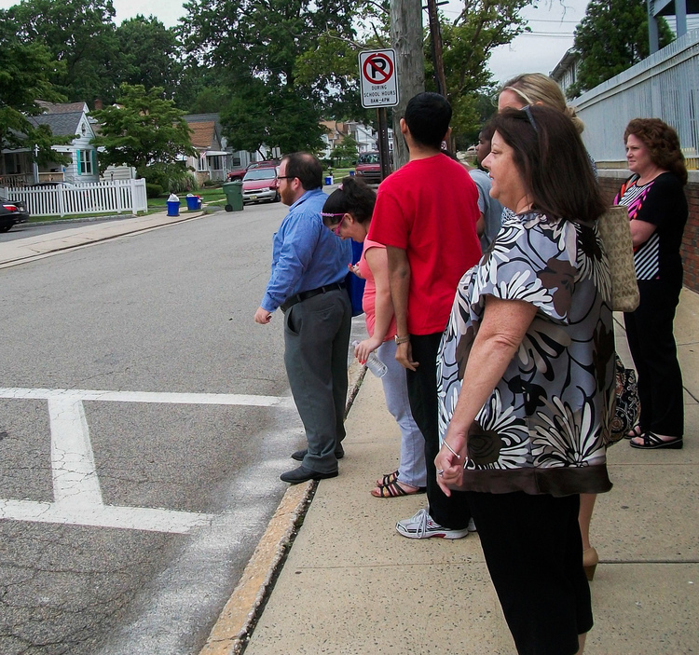
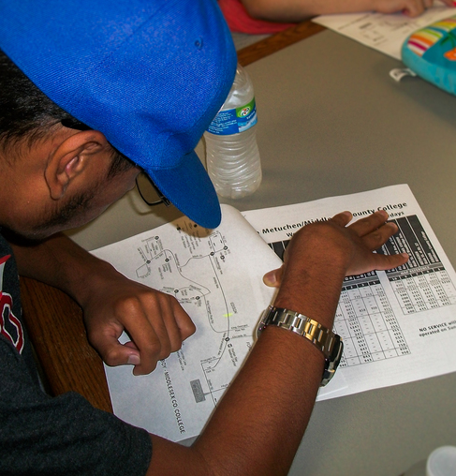
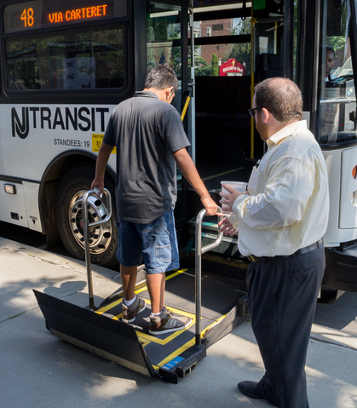
Pre Covid-19 Travel Training
Classroom Instruction
Real-time route checks
In-Person training
Bus demonstrations
Limited virtual training
Notes:
*7 clicks to go through images above, while discussing the points above. (Images from: https://www.adacil.org/latest-updates/travel-training)
Travel training prior to COVID-19 was a vibrant and interactive world of training, it allowed for the interaction and real-world experience of public transportation. Our customers were able to not only see, but touch and feel the vehicles that they would use to travel to their destinations.
Like many of you and your programs our travel training focused on individual travel instruction aka 1-1 instruction as well as group instruction, which was taught in various schools and adult programs throughout the state.
Our program focused on teaching our customers in real-time, in-classroom presentations which were usually followed by a field trip to a local destination that was accessible by public transit. When working with our one on one customers the method was similar, we would meet in their home, discuss the process of travel training, gather information about their destination, and real-time instruction would eventually follow.
(Next slide: COVID-19 Full stop of real-time travel training)

Slide 4
Initial COVID-19 Travel training
Full stop to travel training
No training on vehicles
Sudden shift to online training
Notes:
Then COVID-19 started, and everything stopped.
The sudden change of access to NJ Transit’s public transit system brought on by COVID-19, which in turn effected travel training, caused our program to halt all our real-time travel training. Our program discussed what methods could be implemented to help continue our program, not only for own survival as a program, but more importantly for our customers and their transportation needs.
We knew that we needed to find a solution…
Next slide: Possible solutions to COVID-19 travel training restrictions

Slide 5
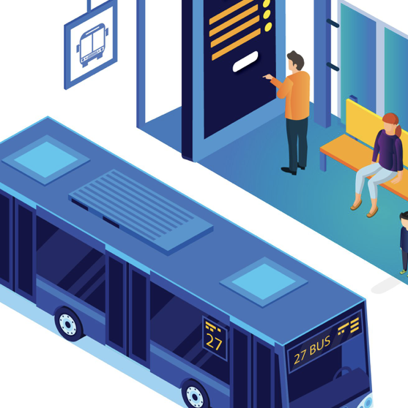
Virtual Training Options
Solutions to COVID-19 Travel Training Restrictions
Notes:
Some of the questions we faced as a travel training program in finding our solution were:
How would our current customers continue their training? Would they be able to continue virtually or over the phone? How would we make sure that their instructional needs were met?
We realized one of our first steps was to research what other programs were doing in response to COVID-19, we discussed how we might adopt a similar online approach and we investigated virtual training platforms.
The solution was creating an online travel training curriculum focusing on the important steps of travel training which could be taught virtually.
Curriculums were created, materials were made, and we began our online training.
Next slide: Online meeting platforms

Slide 6
Virtual Travel Training
Online Meeting Platforms
Notes:
Within a few weeks we were able to launch our online travel training program. Our primary platforms were Zoom, Cisco Webex and Apple Facetime.
We had a group of students who were meeting with their classroom daily on Zoom, so we were able to build our instructional sessions around their schedule. (This group of students would later participate in our virtual trips via Zoom).
Webex would be utilized with customers who found that platform easier to use than Zoom, plus our university had provided us with Webex as a paid platform, which allowed us to instruct more than one customer for longer than 40 minutes (Zoom cutoff unless you have a Pro account).
Facetime was used with customers who didn’t have access to a laptop or were already familiar with that video chat platform, which allowed for a smoother transition to online training.
So now we had the curriculum, the customers and the platforms that best suited their needs.
Now came the virtual trips portion of our online training program.
Next slide: Virtual trips slide

Slide 7
Curating, Creating and Implementing
Methods Used for Designing Virtual Field Trips
Notes:
Now that we have discussed what travel instruction was prior to COVID-19, during the initial start of COVID-19 and how my program adapted to this change let’s discuss the actual methods that I used to create our virtual field trips.
The initial step of creating the virtual field trips was first, consulting with the staff and students from a local program we had been working with prior to COVID.
I talked with the staff and students about some possible trip destinations, we discussed the different sites
Next Slide: Researching and Designing…

Slide 8
Research and Designing Virtual Field Trips
Classroom/Customer Input
Google Search
YouTube
iMovie

Slide 9
Initial COVID-19 Travel training
Full stop to travel training
No training on vehicles
Solutions:
Maximize outreach efforts
Adapt
Improvise
Create
Notes:
This is the current reality of public transit usage in NJ.

Slide 10
Let’s Plan Our Trip!
Using NJ Transit’s Trip Planner
Notes:
The first step in all our virtual trips has been going over NJ Transit’s trip planner.
This provides the ground-work for our trip, it shows the students/customers what their first step in using public transit should always be, planning their trip.
We go over the trip planner and I have the students talk through the steps we need to take while using the trip planner, where our origin is and what our destination is. Next, we talk through the trip plan details, the walking directions, vehicle route number, where we are getting off and what the cost of our trip is. We will also look at and discuss the map of our route and then we go over what the necessary steps are for riding the different modes of transit, whether it is bus, rail or light rail.
Trip planning is always the first step for any successful trip, whether virtual or real world.

Slide 11
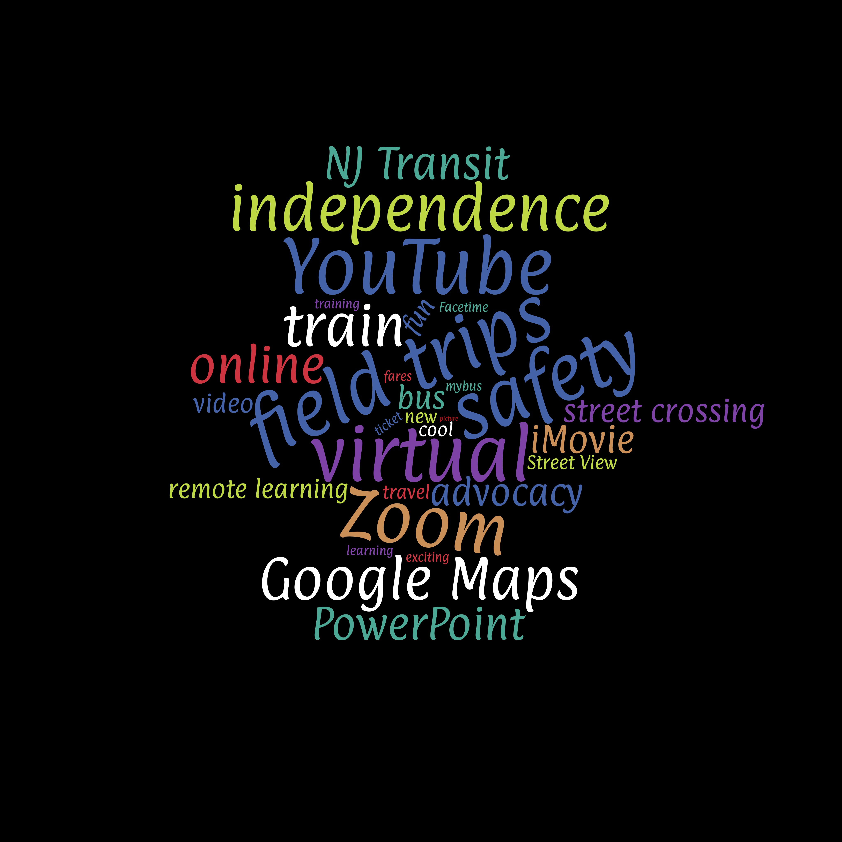
Virtual Field Trip Planning
Benefits and Outcomes
Notes:
*The benefits of virtual field trips is that you are allowing your customers/students to

Slide 12
Find our nearby bus stop
What are some steps we should take to be ready for our bus?
Notes:
So now that we have our trip plan, we will need to head to our local bus stop.
For all of you at the Pal Program it is the bus stop located at the corner of Washington and Main, right in front of the dentist office.
When we are waiting for our bus what should we be getting ready?
Which way should we be looking for the bus?
How can we check to see when the bus is coming?
Mybus?
Transit app?
NJ Transit app?
Call NJ Transit?
Wait for the next bus?
How do we let the bus driver know we want to get on the bus?
Where do we put our money once we board the bus?

Slide 13
Liberty State Park Virtual Tour
#815 NJ Transit bus
815 New Brunswick
Notes:
Today we will be traveling via the #815 NJ Transit bus to New Brunswick rail station.
This is a bus we are all familiar with. We will be taking this bus to New Brunswick and getting off at George at Albany St.
(Further discussion on the bus trip planning to follow on upcoming slides)

Slide 15
New Brunswick Rail Station
Notes:
Once we get off the #815 bus, we will cross George St. and go up the steps to the train platform.
From there we will walk down to the waiting room and purchase our train tickets at either the ticketing window from a ticketing agent or from the TVMs.

Slide 16
New Brunswick Train Station
George and Albany St.
East Bound Side Platform
Notes:
Next, once we arrive at New Brunswick station we will be heading across George St. and walking up the steps to the platform where we will be purchasing our tickets then we will then be boarding the train to Penn Station New York.
Remember we will be getting off at Newark Penn Station not New York Penn Station.
(Further discussion on the train trip planning to follow on upcoming slides)

Slide 17
Purchasing NJ Transit Train Ticket
TVM’s (Ticket Vending Machines) are located inside Newark International Airport station & at the entrance for the AirTrain in the airport
TVM’s accept cash, coins, credit & debit cards
Touch screen
Purchase rail tickets
Notes:
Now that we have arrived at New Brunswick station, we will purchase our tickets for the train to Newark Penn Station using the TVM’s.

Slide 18
How to ride the train
Check the schedule
Purchase our ticket
Get a receipt
Take our change
Check the departure screen (if available)
Listen for announcements
Wait for our train
Have our ticket ready
Listen for our stop
Watch our step as we get off
Notes:
Once we are at the station, we will want to make sure that we follow the steps in the above video.
Once we have our ticket, we will go wait on the platform for our train to Newark Penn Station
We’ll want to listen to the announcements while we are waiting, and we will want to hear Newark Penn Station as one of the stops.
If for some reason we don’t hear the announcements we can always ask a conductor who comes by.

Slide 19
Check departure screen for next train heading towards New York Penn Station
Notes:
Here we can see an example of the departure vision screen.
We can see that there are a couple of trains that are heading to New York, remember we are getting off at Newark Penn Station not New York Penn Station.
What color are the lines where New York is listed? Red
Red is the color of the Northeast Corridor rail line
What track is our train located on?

Slide 22
Liberty State Park Virtual Tour
Newark Penn Station
Notes:
We have now arrived at Newark Penn station, a major station in NJ and a station where people transfer to not only other trains but buses, Newark Light Rail and the PATH train, which is what we will be using next on our trip. Once we get off the train at Newark Penn Station, we will make our way to the PATH train.
Next slide will be the entrance to the PATH train at Newark Penn Station.

Slide 23
Liberty State Park Virtual Tour
PATH Train Entrance
Notes:
The entrance for the PATH train can be found on the ground floor of Newark Penn Station at either Tracks 1 & PATH or Tracks 2 & PATH. Depending on your train and if you are arriving on Track 1 in Newark Penn Station, you might just get off your train and walk across the platform to the entrance of the PATH train.

Slide 24
PATH Ticket Vending Machine
Purchasing your
PATH ticket
Notes:
There are machines that look like the one pictured above are where you can purchase your PATH train ticket.
Follow the screen prompts to successfully purchase your ticket.
You can purchase a two-trip card which is good for two rides or you can purchase a card with multiple rides.
The TVM accepts cash, coins and credit cards.
You can also refill your Metro card at these machines if you are using the PATH more often.

Slide 25
Entrance gates for PATH Train
Notes:
These are the ticketing gates that you need to walk through to wait for and board the PATH train.
You can see that you will either insert or touch your ticket to the gate for it to open.

Slide 26
PATH Fare System
Using a MetroCard
Notes:
*Hyperlink in image to PATH website for information about train fares.
Before we can get on the PATH train, we will need to purchase a Metro Card or two trip card for our trip today. We can purchase this ticket at a TVM for the PATH.

Slide 27
Liberty State Park Virtual Tour
PATH Train towards World Trade Center
Notes:
Once we have found the PATH Train entrance (which is near track 1 and 2) we will purchase our tickets for the PATH train and wait for the next train heading towards WTC (World Trade Center).

Slide 28
PATH Train towards WTC
Notes:
Once it is time to board the train, we will all get on the train and head to Exchange Place.
Once we arrive at Exchange Place, we will be taking one more train to travel to Liberty State Park.
Next, we are going to watch a video that shows all the steps of buying a PATH ticket etc. that we just went over. Pay attention to the video.

Slide 30
Liberty State Park Virtual Tour
Exchange Place PATH Station
Notes:
*Click on above image for Google maps street view of outside view of Exchange Place rail station.
Go through the walking directions from PATH to Light rail station.
Next slide of Exchange Place Light Rail Station.

Slide 31
Hudson-Bergen Light Rail
Exchange Place Light Rail Station
Notes:
*Click on the image and google maps will open to the street view of Exchange Place station.
Talk about the station, how it is different from other stations, the cars drive next to the station, it is at ground level not high above ground like New Brunswick station.
What are some other things the students notice that is different about the station?
Next we will watch a video tour of the Exchange Place Light Rail Station, to get a better look at the station and the trains that come and go to the station.

Slide 32
HBLR – Exchange Place Station
Notes:
Play above video to 2:20 minute marker, great video tour of Exchange Place Light Rail Station.
*Hyperlink: https://www.youtube.com/watch?v=v9BT0iDJsB4&feature=youtu.be
*⁴ᴷ Station Tour | Exchange Place | Hudson-Bergen Light Rail (NJ Transit) by Sebastian Sinisterra

Slide 33
Hudson Bergen Light Rail Map
Exchange Place
Notes:
*Click above image for hyperlink to webpage for HBLR Map.
Discuss the map, go over where we are starting from on the Light Rail (Exchange Place, Jersey City) and where we are taking it to (Liberty State Park).
Show the other train lines that travel near the HBLR etc.

Slide 34
Buying a ticket for Light Rail
Notes:
Talk about how to buy a light rail ticket, the steps that are required and be sure to go over the validation process of the ticket.

Slide 35
The TVM Touch Screen
Notes:
Follow the prompts to purchase a light rail ticket.

Slide 36
Pay with Cash/Credit/Debit Card
Notes:
You can use cash, coins or credit/debit card to purchase your light rail tickets.

Slide 37
Take Ticket and Receipt
Notes:
Be sure to take your receipt and ticket.

Slide 38
Validate your light rail ticket before boarding
Notes:
We take our ticket from the ticketing machine and put it in the small “Validator” it puts a timestamp on the ticket, then we can get on the light rail.
We stamp our ticket in the validator because there are no conductors on the Light Rail trains who collect our tickets, but there are fare enforcement officers who might check to see if we have a ticket and if it is stamped.
If we don’t have a ticket or it isn’t stamped, we might have to pay a $100 fine!
So make sure you stamp your ticket ☺

Slide 39
Board the train towards 8th St. Station or West Side Avenue
Notes:
Once we have our ticket ready and validated, we’ll want to look and listen for the next train heading towards 8th St. Station or West Side Avenue, we will take that train to Liberty State Park station.
Next slide “Find a Seat”

Slide 40
Find a seat
Notes:
Once on the train be sure to find a seat quickly on the train.
The train will start to move once the doors have closed.
Be sure to hold onto the handrails once you board the train so that you don’t fall once the train moves.
Be aware of where you are sitting on the train, if you are sitting in the accessible seating area, which will be labeled with signs on the window near the seats, be sure to offer your seat to someone who might not be able to stand or might need a seat close to the door.
We want to listen for our stop, Liberty State Park.
Next slide of arriving at Liberty State Park Light Rail Station.

Slide 41
Liberty State Park Light Rail Station
Notes:
*Click on image for hyperlink of google maps street view of LSP Light Rail station.
We have arrived at Liberty State Park Light Rail Station!!
Now we will take a look around using google maps street view of the station and nearby areas.

Slide 42
Liberty State Park Historical Rail Terminal
Notes:
*3 1/2 minutes video from NJTV news about Liberty State Park Historical Train Terminal.
“A look at the historic rail terminal in Liberty State Park” by NJTV News : https://www.youtube.com/watch?v=4p1st0ZLjiA&t=2s
A good intro video to the area, we’ll stop here today and pick up next time with our ferry trip to Ellis Island and Liberty Island.

Slide 43
Notes:
This where we will pause for today.
When we meet next time we will start our tour to Ellis Island and Liberty Island.

Slide 44
Virtual Tour of Ellis Island and Liberty Island
Notes:
We will now start our trip to Ellis Island and Liberty Island which is where the Statue of Liberty resides.
We will be boarding a ferry and traveling to the island.

Slide 45
Travel from Liberty State Park
Notes:
*Following video will describe how to travel from Liberty State Park to Ellis Island and Liberty Island, they also mention how you can use NJT Light Rail to travel to Liberty State Park. This is a good intro video for how to travel to this area and how to use the ferry, they talk about purchasing the tickets and where to pick up the ferry for both going to and coming from Ellis Island and Liberty Island.
“Travel from Liberty State Park, NJ” by Statuetv YouTube: https://www.youtube.com/watch?v=rUGveu3A3xQ&feature=youtu.be

Slide 46
Virtual Tour of Ellis Island
National Park Service Tour
Notes:
Click on above image to launch National Park Service Virtual tour.
Click through some of the buildings and talk about the history of Ellis Island etc.
https://www.nps.gov/hdp/exhibits/ellis/Ellis_Index.html?html5=prefer

Slide 47
Ellis Island 360 Virtual Tour
Notes:
*4 ½ minute video of Ellis Island video and narrated tour. Video will open in web browser, this way you can control the camera view. Follow the arrows on the video.
Ellis Island 360 (360º Narrated Video Tour) by Morgan D. Foley-Hull: https://www.youtube.com/watch?v=uUVpvbrRGYg&t=11s

Slide 48
Virtual Tour of The Statue of Liberty
Videos
&
360 Virtual Tours
Notes:
Now we are going to travel to and visit The Statue of Liberty!
We have some videos to watch and a couple virtual tours to travel through.
Let’s GO!

Slide 49
Virtual Tour of Liberty Island
National Park Service Tour
Notes:
*Click above image for National Park Service website. Great website and detail tour of Statue of Liberty. https://www.nps.gov/hdp/exhibits/stli/stli_tour.html
Tons of features, start the tour at the docks and then follow the star icons on the screen to click to the next location.
You can read through the descriptions and text that NPS has provided.

Slide 50
The New Statue of Liberty Museum
Notes:
NJTV News “New museum opens its doors to Statue of Liberty visitors” : https://www.youtube.com/watch?v=uqUJe3HENww&feature=youtu.be
3-minute video about the new Statue of Liberty Museum which was completed in 2019.
Show this video then go to the virtual tour of the museum website.

Slide 51
The Statue of Liberty Museum
Notes:
Another video of the new Statue of Liberty Museum, this video shows a slightly deeper look Into the door and some of its features.
*2-minute ABC 7 News video: “New museum tells the story of the Statue of Liberty” : https://www.youtube.com/watch?v=Q9UJex3z75g&feature=youtu.be
Show this video then go to the virtual tour of the museum website.

Slide 52
Living on Liberty Island
Notes:
*Click on above image to open YouTube link. (You will need to switch your sharing screen to your internet browser, Firefox, Chrome etc.)
*CBS News video from 2011 about a Park Ranger and his family who live on Liberty Island!
"Tour of a lifetime" of Statue of Liberty” : https://www.youtube.com/watch?v=F3wjRQDQnzk

Slide 53
Virtual Tour of Statue of Liberty Museum
A look inside
Statue of Liberty
Museum
Notes:
*Click on above image to open hyperlink to website for virtual tour of Liberty Island.
Click the arrows on the ground to follow the tour.

Slide 54
Time to head back to school
Notes:
Now that we have seen all these exciting things at Liberty State Park, Ellis Island and Liberty Island and learned so much it is time to head back to school.

Slide 55
Liberty Island State Park Ferry
Board the Ferry
to
Liberty State Park
Notes:
So we are now going to take the ferry boat back to Liberty State Park and start our trip back to Sayreville.

Slide 56
Heading back to Liberty State Park
Notes:
We will now take the ferry from Liberty Island back to Liberty State Park.
Once we are back at Liberty State Park, we’ll walk to the light rail station and take the train back to Jersey City.

Slide 57
Let’s Plan Our Trip!
Using NJ Transit’s Trip Planner
Notes:
Let’s take a look at NJ Transit trip planner to see how we will get back to school.
*Next slide will briefly discuss if we have missed our trip because maybe our tour or lunch was too long.

Slide 58
What happens if we miss our bus or train?
Troubleshooting mistakes, cancellations and weather issues.
Notes:
If we were really taking this trip, along the way we may experience some delays on our train or bus, we will talk about how to manage these setbacks and how we can troubleshoot any possible delays or cancellations etc. that might come up on an actual trip to the airport. (Talk about missing the bus, not having enough fare, how you can purchase bus/train tickets on your phone, talk about the bus/train coming late, how to problem solve all of these issues and any others that might come to mind).

Slide 59
Liberty State Park Light Rail Station
Notes:
*Click on image for hyperlink of google maps street view of LSP Light Rail station.
We have arrived at Liberty State Park Light Rail Station.
We’ll now purchase our train tickets and take the light rail back to Exchange Place station and then we’ll walk to Exchange Place PATH station.
Next slide will be of the HBLR map and go over the route and station we need to travel to.

Slide 60
Hudson Bergen Light Rail Map
Liberty State Park
Notes:
*Click above image for hyperlink to webpage for HBLR Map.
Discuss the map, go over where we are starting from on the Light Rail (Liberty State Park) and where we are taking it to (Exchange Place, Jersey City)
Show the other train lines that travel near the HBLR etc.

Slide 61
Buying a ticket for Light Rail
Notes:
Talk about how to buy a light rail ticket, the steps that are required and be sure to go over the validation process of the ticket.

Slide 62
The TVM Touch Screen
Notes:
Follow the prompts to purchase a light rail ticket.

Slide 63
Pay with Cash/Credit/Debit Card
Notes:
You can use cash, coins or credit/debit card to purchase your light rail tickets.

Slide 64
Take Ticket and Receipt
Notes:
Be sure to take your receipt and ticket.

Slide 65
Validate your light rail ticket before boarding
Notes:
We take our ticket from the ticketing machine and put it in the small “Validator” it puts a timestamp on the ticket, then we can get on the light rail.

Slide 66
Board the train towards Tonnelle Ave or Hoboken
Notes:
Once we have our ticket ready and validated, we’ll want to look and listen for the next train heading towards Tonnelle Ave. or Hoboken, we will take that train to Liberty State Park station.
Next slide “Find a Seat”

Slide 67
Find a seat
Notes:
Once on the train be sure to find a seat quickly on the train.
The train will start to move once the doors have closed.
Be sure to hold onto the handrails once you board the train so that you don’t fall once the train moves.
Be aware of where you are sitting on the train, if you are sitting in the accessible seating area, which will be labeled with signs on the window near the seats, be sure to offer your seat.
We want to listen for our stop, Liberty State Park
Next slide of arriving at Liberty State Park Light Rail Station.

Slide 68
Hudson-Bergen Light Rail
Exchange Place Light Rail Station
Notes:
*Click on the image and google maps will open to the street view of Exchange Place station.
Now we have arrived back at Exchange Place and we will head over to the PATH station.
Use the google maps view and show the walking directions to the PATH station at Exchange Place.

Slide 69
Liberty State Park Virtual Tour
Exchange Place PATH Station
Notes:
*Click on above image for Google maps street view of outside view of Exchange Place rail station.

Slide 70
Entrance gates for PATH Train
Notes:
Once we arrive at the PATH Station, we will get our tickets ready, we still have a single trip remaining on all our Metro Cards, we’ll insert our cards and then board the train.
These are the ticketing gates that you need to walk through to wait for and board the PATH train.
You can see that you will either insert or touch your ticket to the gate for it to open.

Slide 71
PATH Fare System
Using a MetroCard
Notes:
*Hyperlink in image to PATH website for information about train fares.
Before we can get on the PATH train, we will need to purchase a Metro Card or two trip card for our trip today. We can purchase this ticket at a TVM for the PATH.

Slide 72
PATH train to Newark Penn Station
Notes:
We need to wait for our PATH train to head back to Newark Penn Station.

Slide 73
Arrive at Newark Penn Station – Platform H
Notes:
Once we arrive in Newark Penn Station we’ll need to navigate our way to the next platform for our train to head back to New Brunswick.

Slide 74
Make our way through the gates
Notes:
We’ll need to walk through the gates or the there might be a large open gate, the accessible gate which we can walk through as well.
Next Slide – Departure screen at Newark Penn Station.

Slide 75
Check departure screen for trains to Trenton
Notes:
We now want to check the departure screen for the next Northeast Corridor train heading towards Trenton.
What color is our train line to New Brunswick? Red
What do we need to buy before or make sure we have before we board the train? Train ticket.
Discuss any other reminders you feel necessary.

Slide 76
Purchasing NJ Transit Train Ticket
TVM’s (Ticket Vending Machines) are located inside Newark International Airport station & at the entrance for the AirTrain in the airport
TVM’s accept cash, coins, credit & debit cards
Touch screen
Purchase rail tickets
Notes:
Now that we know which platform our train is arriving at we will purchase our tickets for the train back to New Brunswick Station using the TVM’s.

Slide 77
Leaving Newark Penn Station
Notes:
We need to be careful when we board the train.
Where should we wait for the train?
Should we wait on the yellow line?
How should we board the train?
Should we push and shove to get on?
Where are we taking the train to?
Discuss other safety and travel tips for riding the train.

Slide 79
Washington and Main St.
What do we need to press to request our stop?
Notes:
Here is our stop for the PAL Program.
What do we do?

Slide 80
We made it back!
Notes:
We have now arrived back at the PAL Program.
What did we learn today/this trip?
We learned about how to ride the bus, the train and the airtrain.
We learned about to plan our trip using NJ Transit’s website.
We learned about the history of the airport, when it was built, all the famous people who have flown there, what the airport is becoming and how it is changing into a very modern airport.
We also learned about the fire dept. at the airport and how they train for their job.
We also learned about air traffic controllers and all that they do.
We learned a lot today!!
Did everyone have a good time?
Are there any questions?
Thank you all so much!!

Slide 81
Thank you!
Jeffrey Dennis, BA
Research Program Coordinator/Travel Instructor
NJTIP @ Rutgers – Travel Training
33 Livingston Ave
New Brunswick NJ 08901
Cell: (908)-268-9642
Email: jeffdenn@ejb.rutgers.edu
Web: njtip.Rutgers.edu

